Slide 1
Stock Price Prediction

Slide 2
Overview
Introduction
Data Overview
EDA
ARIMA
LSTM
To Do
Model Performance

Slide 3
Data Overview
Stock Price Dataset-
Minute data
Day data

Slide 4
Minute Data Overview
Dataset Size : 1493450
No of features : 25
Target Variable : close
No of Symbols : 602
Null value columns - None
SPY Symbol contains maximum no. of data points. i.e. 5534
Duration : 2020-06-03 04:00:01 - 2020-06-10 20:00:01

Slide 5
Day data overview
Dataset Size : 209569
No of features : 14
Target Variable : Close
No of Symbols : 3828
Null value columns - volume_change, volume_score, bullish, bearish
AIM Symbol contains maximum no. of data points. i.e. 55
Duration : 25/3/2020 - 12/6/2020

Slide 6
Features
Replaced outliers with last seen value.
Generic class -
Initialize with dataset.
Predict based on symbol input.

Slide 7
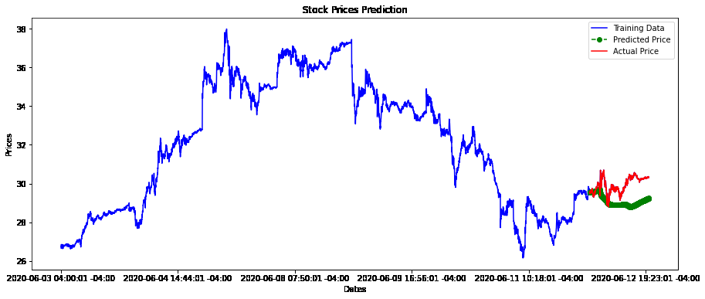
Model : ARIMAX (Symbol : DAL)

Slide 8
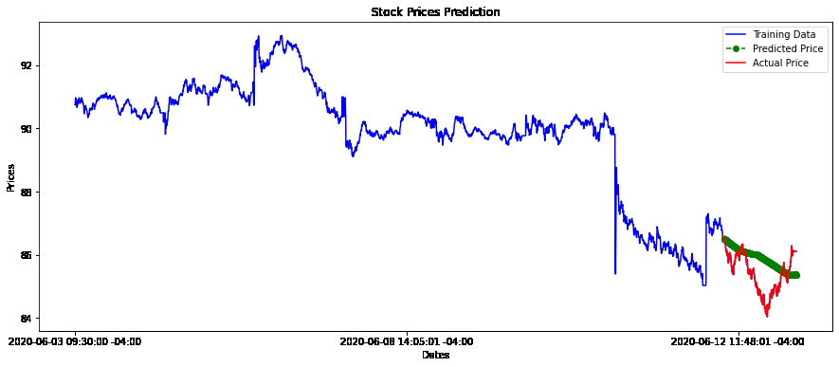
Model : ARIMAX (Symbol : MSFT)

Slide 9
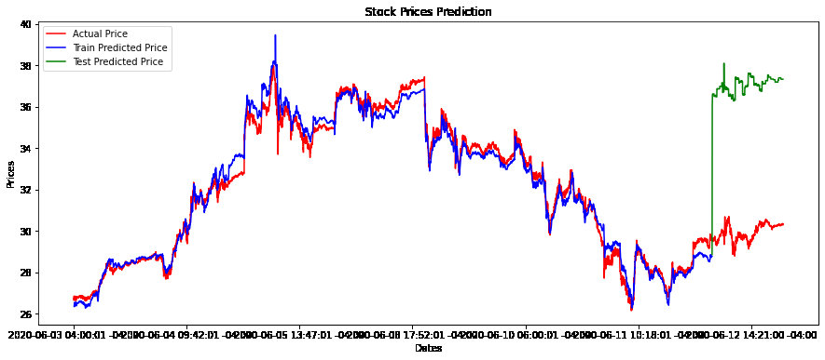
Model : LSTM (Symbol : DAL)

Slide 10
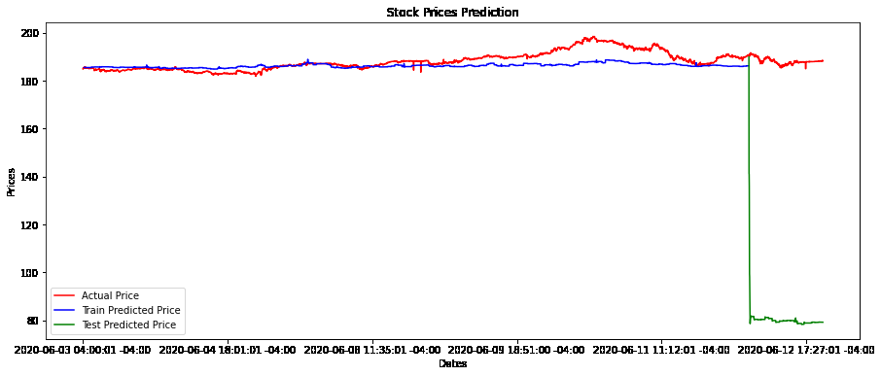
Model : LSTM (Symbol : DAL)

Slide 11
Model Performance
Model | Symbol | No.of Records | Train-Val -Test split | Train RMSE | Val RMSE | Test RMSE
ARIMAX | DAL | 7538 | 90 : 10 : 10 | ------- | 3.99 | 0.97
ARIMAX | MSFT | 6139 | 90 : 10 : 10 | ------- | 3.50 | 1.88
ARIMAX | A | 3264 | 90 : 10 : 10 | ------- | 1.08 | 0.754
LSTM | DAL | 7538 | 90 : 10 | 0.405 | ------ | 7.112
LSTM | MSFT | 6139 | 90 : 10 | 3.72 | ------ | 107.9
LSTM | A | 3264 | 90 : 10 | 8.5 | ------ | 36.74

Slide 12
Observation
Model degrading when predicting too much in future.
Simple LSTM didn’t work well.

Slide 13
To Do
Use deep learning models e.g. bidirectional lstm, bidirectional gru.
Use day data for model building.

Slide 14
Thank You!
Jayanth Rasamsetti
340S Lemon Ave, #9172, Walnut, CA, 91789, United States
+1 (917) 7401966
jay@sgmoid.com

